Slide 1


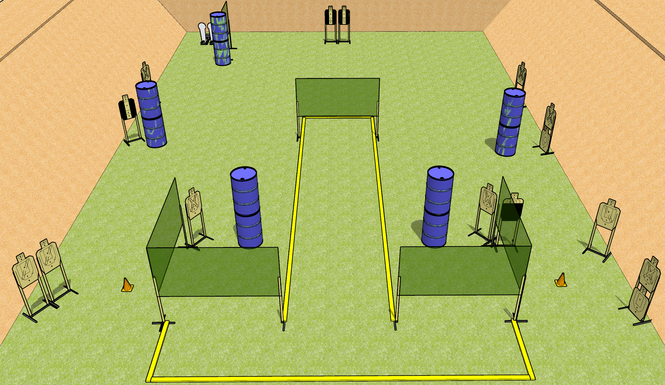
 | Dothan Gun Club – USPSA Match Out of the Gutter Course Designer : Drew Coleman
START POSITION : Straddling (one foot in, one foot out of the shooting area) leftmost or rightmost fault line, wrists below belt
GUN READY CONDITION : Pistol loaded and holstered. PCC loaded, held with both hands, shouldered, safety on, pointed at orange cone. |  | SCORING: Comstock, 32 rounds TARGETS: 15 paper, 2 Steel SCORED HITS: Best 2 on paper, steel until down START-STOP: Audible, last shot RULES:
STAGE PROCEDURE: Engage targets as they become available from within the fault lines.

Slide 2
Out of the Gutter
Written Stage Briefing
Out of the Gutter is a 32 round, 160 point, Comstock field course. There are fifteen USPSA targets and two colt poppers. The best two hits on paper will score, and steel must fall to score. The start signal is audible.
Handgun start position is standing straddling the leftmost or rightmost fault line, with one foot in and one foot out of the shooting area. Handgun is loaded and holstered, wrists below belt.
PCC start position is standing straddling the leftmost or rightmost fault line, with one foot in and one foot out of the shooting area. Loaded carbine is held with both hands, shouldered, safety on, pointed at either orange cone.
On start signal, engage targets as they become available from within the shooting area.

